Slide 1
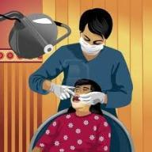
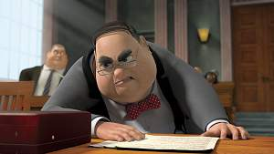
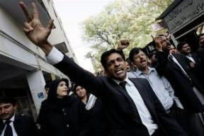


IS SOCIAL WORK
A PROFESSION?
IMRAN A. SAJID, PhD
Lecturer (Social Work)
University of Peshawar, Pakistan
Web: ww.uop.edu.pk
Email: imranahmad131@uop.edu.pk
This lecture is based on the essay of Abraham Flexner

Slide 2
The word "profession" or "professional" may be loosely or strictly used.
In its, broadest significance it is simply the opposite of the word "amateur."
A person is, in this sense, a "professional" if his entire time is devoted to an activity, as against one who is only transiently or provisionally so engaged.
Amateur: Unskilled person,
somebody doing something for pleasure

Slide 3

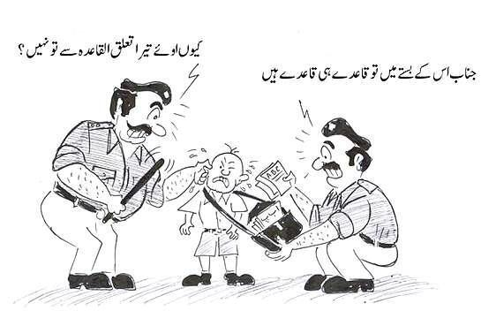

Slide 4



Slide 5
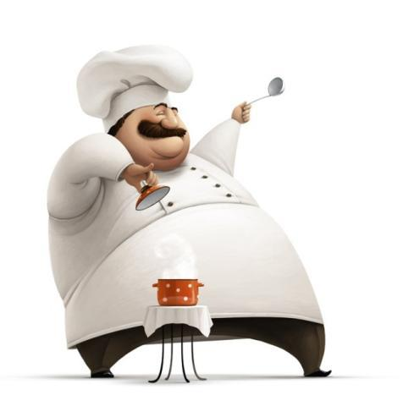


Slide 6



Slide 7


Slide 8
Social work is, from this point of view, a profession for those who make a full-time job of it;
It is not a profession for those who incidentally contribute part of themselves to active philanthropy.

Slide 9
However, every difficult occupation requires the entire time of those who take it seriously.
Notes:
The question put here is a more technical one.

Slide 10
Almost any occupation, not obviously a business, is apt to classify itself as a profession.
Doctors, lawyers, preachers, musicians, engineers, journalists, trained nurses, and dancing masters—all speak of their "profession".

Slide 11
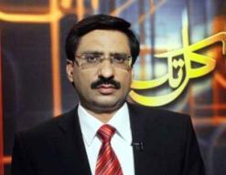

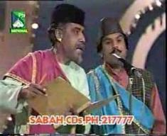

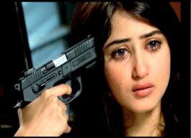
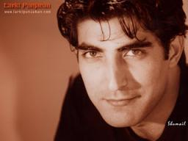

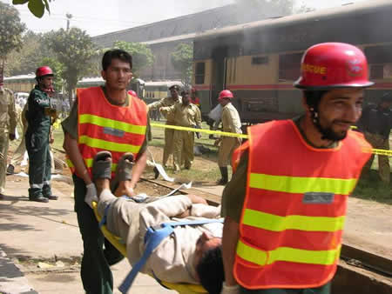
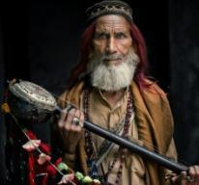



Slide 12
If there is a
  dancing profession,
  a baseball profession,
  an acting profession,
  a nursing profession,
  an artistic profession,
  a musical profession,
  a medical profession, and
  a legal profession—to mention no others
—the term profession is too vague to be fought for.

Slide 13
But to make a profession in the genuine sense, something more than a mere claim or an academic degree is needed.
There are certain objective standards that can be formulated.
Social work is interested in being recognized as a profession only if the term is limited to activities possessing these criteria.

Slide 14
What are at this moment the criteria of a profession and to consider whether social work conforms to them?

Slide 15
There are a few professions universally admitted to be such,
  Law,
  Medicine, and
  Engineering
Let us set a criteria for a profession with the help of above three professions.

Slide 16
Criteria for a Profession
Intellectual Activity and Individual Responsibility
Profession is Learned
Profession has a Practical Object
Profession possess an Educationally Communicable Technique
Self-organization through a Professional Association
Becoming Altruistic in Motivation
CRITERIA: standard for judging things : or an accepted standard used in making a decision or judgment about something.
Notes:
کسوٹی، معیار، جانچ کا اصول

Slide 17


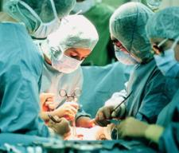

1. Intellectual* Activity and
Individual Responsibility
The first mark of a profession is that the activities involved are essentially intellectual in character.
Manual work is not necessarily excluded; the use of tools is not necessarily excluded.
But the activity is mainly Intellectual in nature.
*relating to thought process

Slide 18

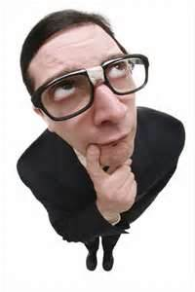
The real character of the activity is the Thinking Process.
Doctors, Engineers, and legal attorneys, their activities involve a lot of thinking.
That is characteristic of a profession.

Slide 19

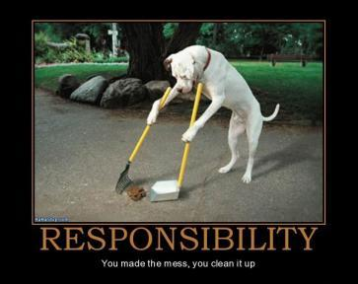
Individual Responsibility
Wherever intelligence plays freely, the responsibility of the practitioner is at once large and personal.
The problems to be dealt with are complicated;
The facilities at hand, more or less abundant and various;
the agent—physician, engineer, lawyer, or social worker—exercises a very large discretion* as to what he shall do.
*freedom to decide

Slide 20


This quality of responsibility follows from the fact that professions are intellectual in character;
for in all intellectual operations, the thinker takes upon himself a risk.

Slide 21
Only technical jobs can not be called professional; e.g. Mason, mechanic, plumber, paramedics, nurse, etc.
for the human mind does not, in technical activities, enjoy the requisite freedom of scope or carry the requisite burden of personal responsibility.
Some one back has done the thinking and therefore bears the responsibility, and he alone deserves to be considered professional.

Slide 22



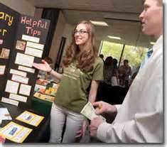

2. Profession is Learned
The second criterion of the profession is that it is learned,
There is constant learning.

Slide 23
3. Profession is has a Practical Object
Professions are definitely practical.
They have a practical objective.
The professional man must have an absolutely definite and practical object.
His processes are essentially intellectual;
his raw material is derived from the world of learning;
thereupon he must do with it a clean-cut, concrete task.

Slide 24
Review
Intellectual Activity and Individual Responsibility
Learned Activity
Practical objective

Slide 25


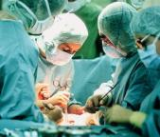
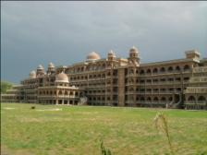
4. Profession possesses an Educationally Communicable Technique
Each of the mentioned profession (i.e. law, medicine, engineering), possesses a technique capable of communication through an orderly and highly specialized educational discipline.
the members of a given profession are pretty well agreed as to the specific objects that the profession seeks to fulfill, and
the specific kinds of skill that the practitioner of the profession must master in order to attain the object in question.
1
2
3
4

Slide 26


5. Self-organization through a Professional Association
A profession is a brotherhood—almost a caste.
They organize themselves in the form of a professional institution/organization.
A strong class consciousness.
We call this brotherhood as a Professional Association.
5
1
2
3
4
Notes:
Qualifications to become a member of that brotherhood are determined by the nature of the responsibility alone.

Slide 27
6. Becoming Altruistic in Motivation
On the whole, organized groups of this kind are, under democratic conditions, apt to be more responsive to public interest than are unorganized and isolated individuals.
The professional organization is explicitly and admittedly meant for the advancement of the common social interest.
Devotion to well-doing is more and more likely to become an accepted mark of professional activity;

Slide 28
Let me now review briefly the six criteria which we have mentioned:
professions involve essentially intellectual operations with large individual responsibility;
they derive their raw material from science and learning;
this material they work up to a practical and definite end;
they possess an educationally communicable technique;
they tend to self-organization;
they are becoming increasingly altruistic in motivation.

Slide 29
Lets test some of the occupations.

Slide 30

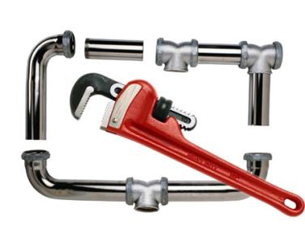


Professional Characteristics
Definite in Purpose
techniques communicable through education.
Organized in associations
Objections
Mechanical Activity (Act on Instruments)
Data used comes from experience instead of immediate science and learning
No altruistic ambitions
IT’S A HANDICRAFT

Slide 31

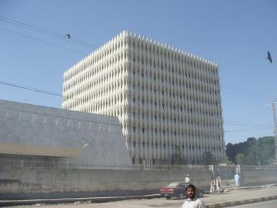

Professional Characteristics
Definite Purpose
Intellectual Activity
Class Consciousness (Professional Associations)
Objections
Motivated only for Financial Profit
IT’S A TRADE

Slide 32
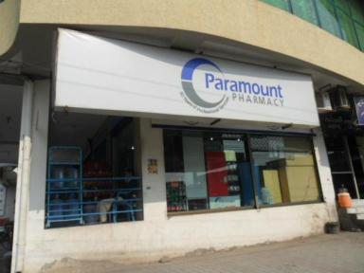

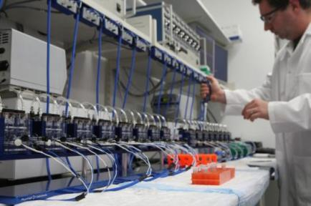

Professional Characteristics
Definite in Purpose
Techniques communicable
Knowledge comes from Learning
Objections
Responsibility is not primary
IT’S A HIGHER FORM OF HANDICRAFT

Slide 33
Social Work
In 1926, when Abraham Flaxner wrote this essay, Social Work was not a recognized profession. But today, it is a profession. Because it involves
Intellectual Activity
Personal Responsibility
Definite in Purpose
Techniques communicable through educational discipline
Class consciousness (Professional association)
Altruistic in motivation
IT’S A PROFESSION
ہے زندگی کا مقصد اوروں کے کام آنا

Slide 34
In Pakistan
professional association exists but not officially recognized as of yet.
APSW→All Pakistan Social Workers Association

Slide 35
Q/A

Slide 36
Thank You

